Slide 1
Lab 9

Slide 2
Purpose
To demonstrate knowledge of
User Interfaces

Slide 3
Classes
Lab 7 Classes +…
MainFrame extends JFrame…
CustomerDialog extends JDialog…

Slide 4

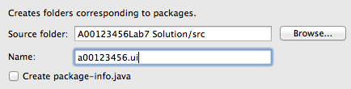
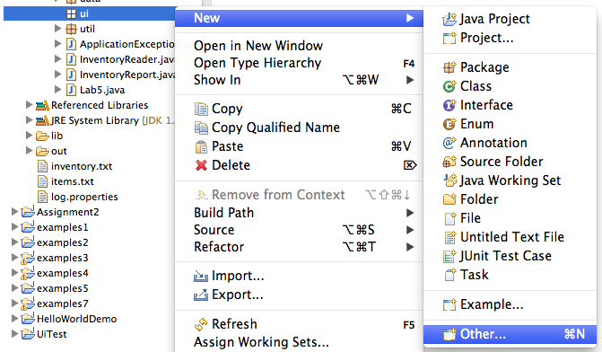
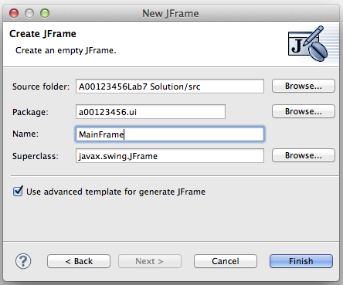

UI / JFrame
Add a new sub-package ‘ui’
And a frame…

Slide 5
More Changes
Move EventQueue.invokeLater to your Lab9 main method
public static void createUI() {
// set the Nimbus look and feel...
// create and show the user interface
EventQueue.invokeLater(new Runnable() {
public void run() {
try {
MainFrame mainFrame = new MainFrame(customerDAO);
mainFrame.setVisible(true);
} catch (Exception e) {
e.printStackTrace();
}
}
});
}
Set the Nimbus Look & Feel (see the lecture notes)
You may need to pass the customerDAO to the MainFrame

Slide 6
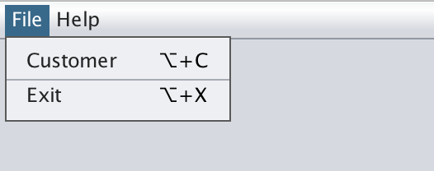
UI / Menu
Add a menubar to the frame with the following menus and menuitems
File
Customer
Exit
Help
About
Note: The 'Alt' symbol may look different on different platforms

Slide 7
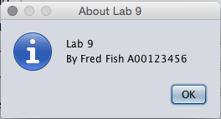
UI / Actions
Add actions to:
exit the program when ‘Exit’ is pressed
Hint: System.exit(0);
display a dialog box similar to the following when ‘About’ is pressed:
(hint: a new line is created with ‘\n’)
Add an accellerator to 'About' so when 'F1' is pressed, the 'About' message is also shown

Slide 8
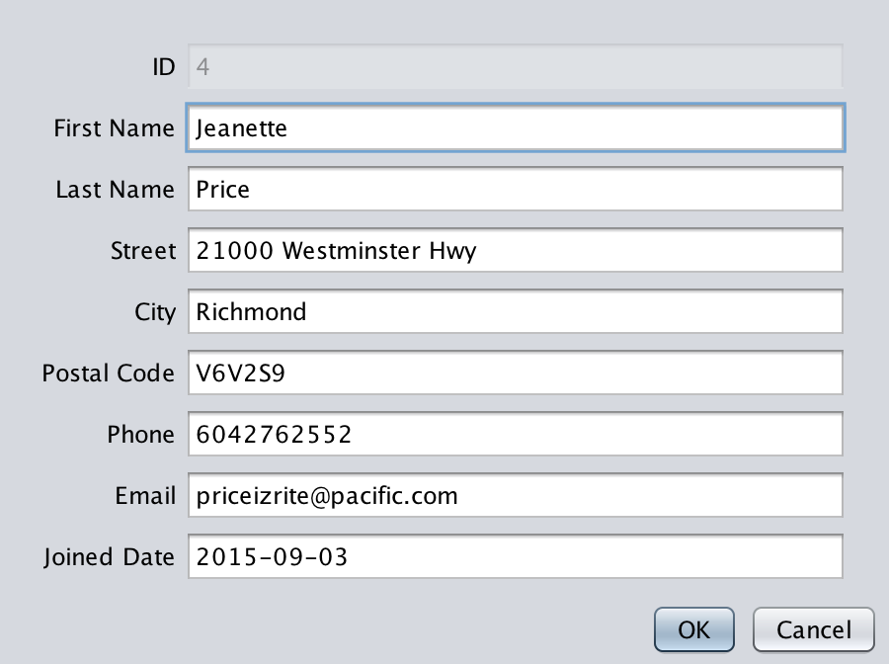
UI / CustomerDialog
Each time File > Customer is selected, a random customer will be passed to the dialog; add an accelerator of Alt-C
Both ‘OK’ and ‘Cancel’ will close the dialog

Slide 9
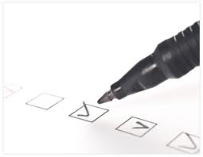
Checklist
I have:
Met all the functional requirements
Followed the java coding conventions
Used a file template to add my name & student number to all source files
Used packages; the root package is my student number, ex. package a00123456…;
Used great object-oriented design
Included all source code & required resources
Created a runnable Jar file for testing
Zipped up all my files into a single file named <your student number>.zip, ex. A00123456.zip
Submitted my lab before the due date & time

